Slide 1
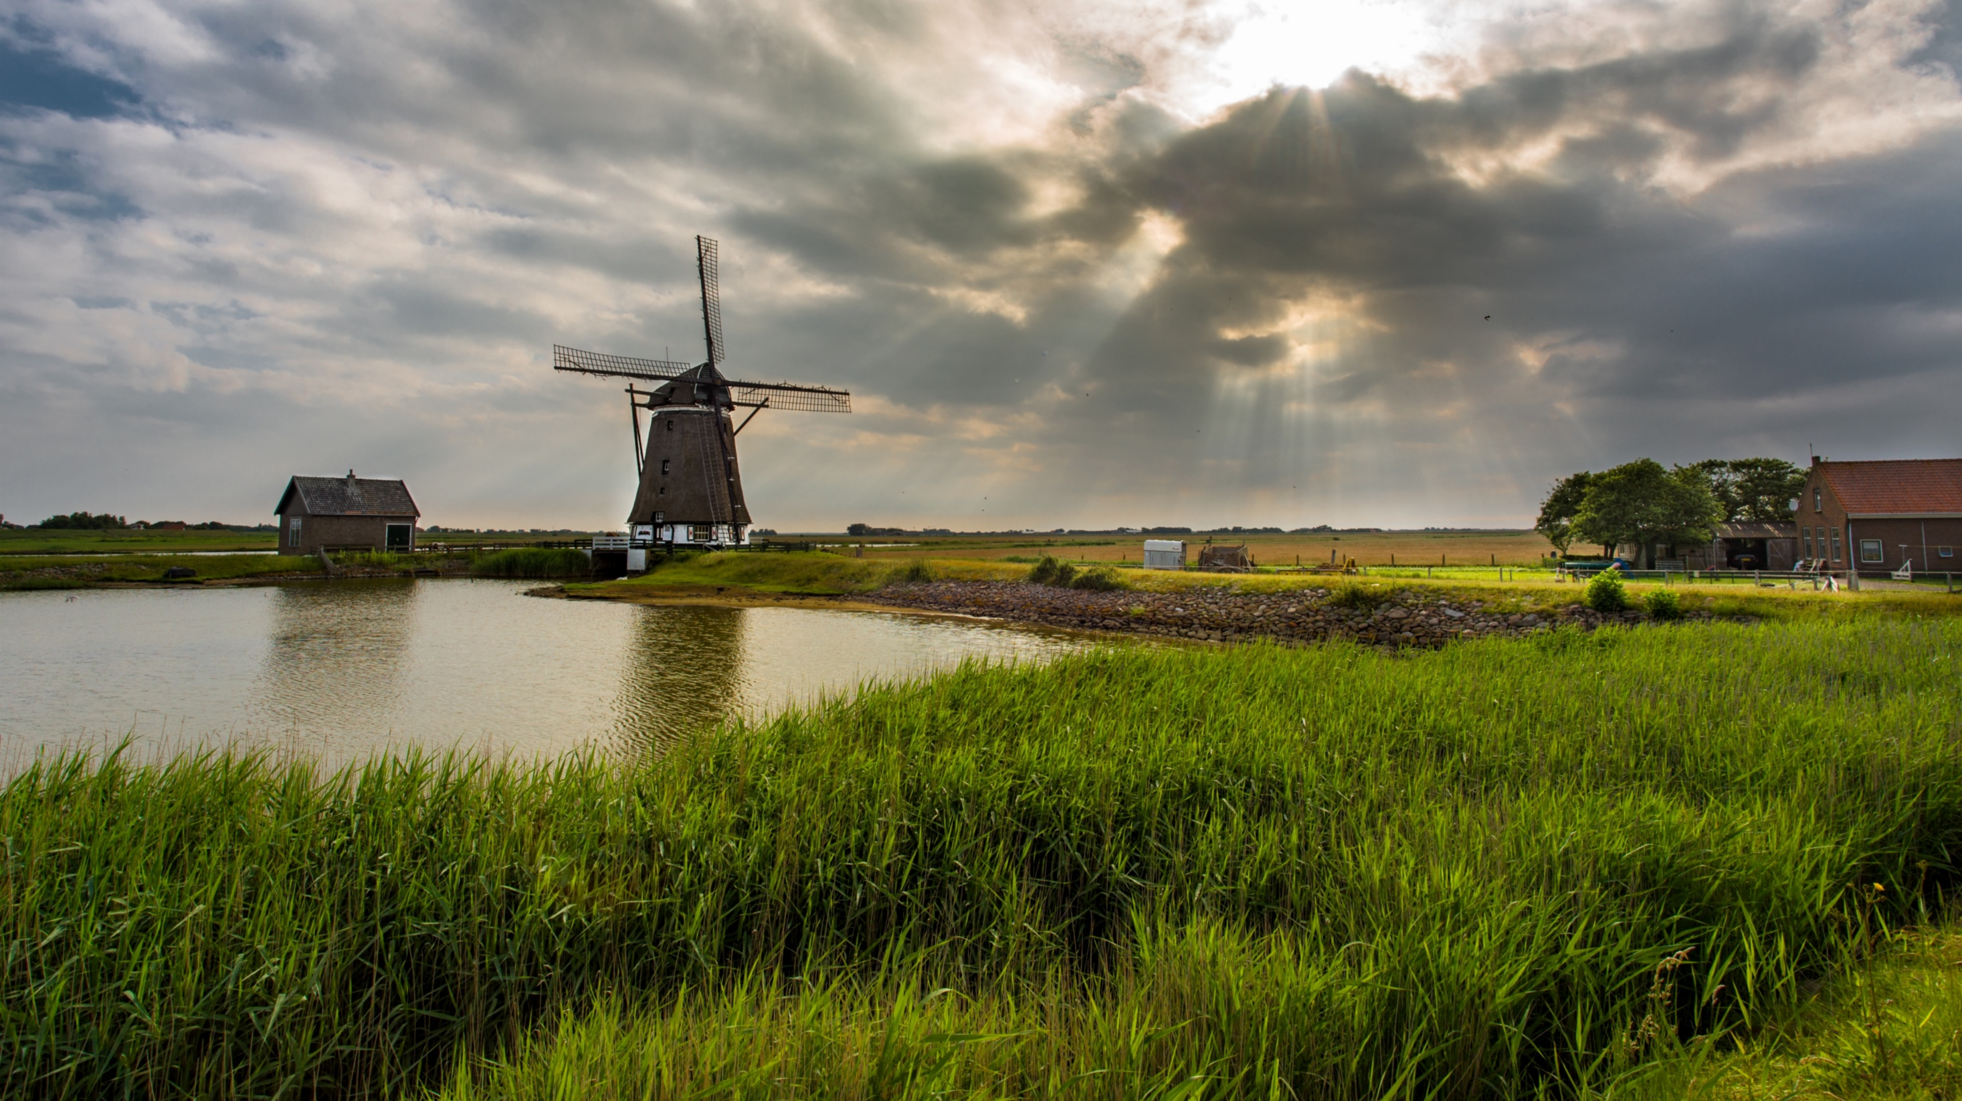
Geonovum
Gebruik van de nieuwe OGC API’s
Pieter Bresters

Slide 2
OGC API Features
Landing page https://api.pdok.nl/lv/bgt/ogc/v1
OAS https://api.pdok.nl/lv/bgt/ogc/v1/api
Collections https://api.pdok.nl/lv/bgt/ogc/v1/collections
Collection-id https://api.pdok.nl/lv/bgt/ogc/v1/collections/bak
Items https://api.pdok.nl/lv/bgt/ogc/v1/collections/bak/items
Item-id:
https://api.pdok.nl/lv/bgt/ogc/v1/collections/bak/items/5d394ef5-6a5d-5011-a729-29def1c51dd9
Parameters ?f=json of ?f=html

Slide 3
OGC API Tiles
Landing page https://api.pdok.nl/lv/bgt/ogc/v1
OAS https://api.pdok.nl/lv/bgt/ogc/v1/api
Tiles https://api.pdok.nl/lv/bag/ogc/v1_0/tiles
Tile Matrix Set
https://api.pdok.nl/lv/bag/ogc/v1_0/tiles/NetherlandsRDNewQuad
URL template
https://api.pdok.nl/lv/bag/ogc/v1_0/tiles/NetherlandsRDNewQuad/{z}/{Y}/{X}?f=mvt
Tile
https://api.pdok.nl/lv/bag/ogc/v1_0/tiles/NetherlandsRDNewQuad/12/2046/2048?f=mvt
Styles https://api.pdok.nl/lv/bag/ogc/v1_0/styles
Parameters ?f=json of ?f=html

Slide 4
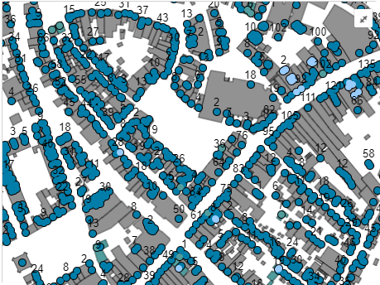
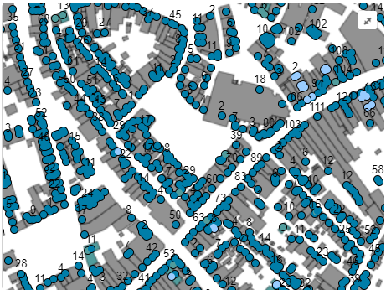
BAG Vector Tiles
https://api.pdok.nl/lv/bag/ogc/v1_0/tiles/NetherlandsRDNewQuad/12/2046/2047?f=mvt
https://api.pdok.nl/lv/bag/ogc/v1_0/tiles/EuropeanETRS89_LAEAQuad/14/8237/7303?f=mvt

Slide 5
BAG Vector Tiles
https://api.pdok.nl/lv/bag/ogc/v1_0/tiles/NetherlandsRDNewQuad/12/2046/2047?f=mvt
https://api.pdok.nl/lv/bag/ogc/v1_0/tiles/EuropeanETRS89_LAEAQuad/14/8237/7303?f=mvt

Slide 6
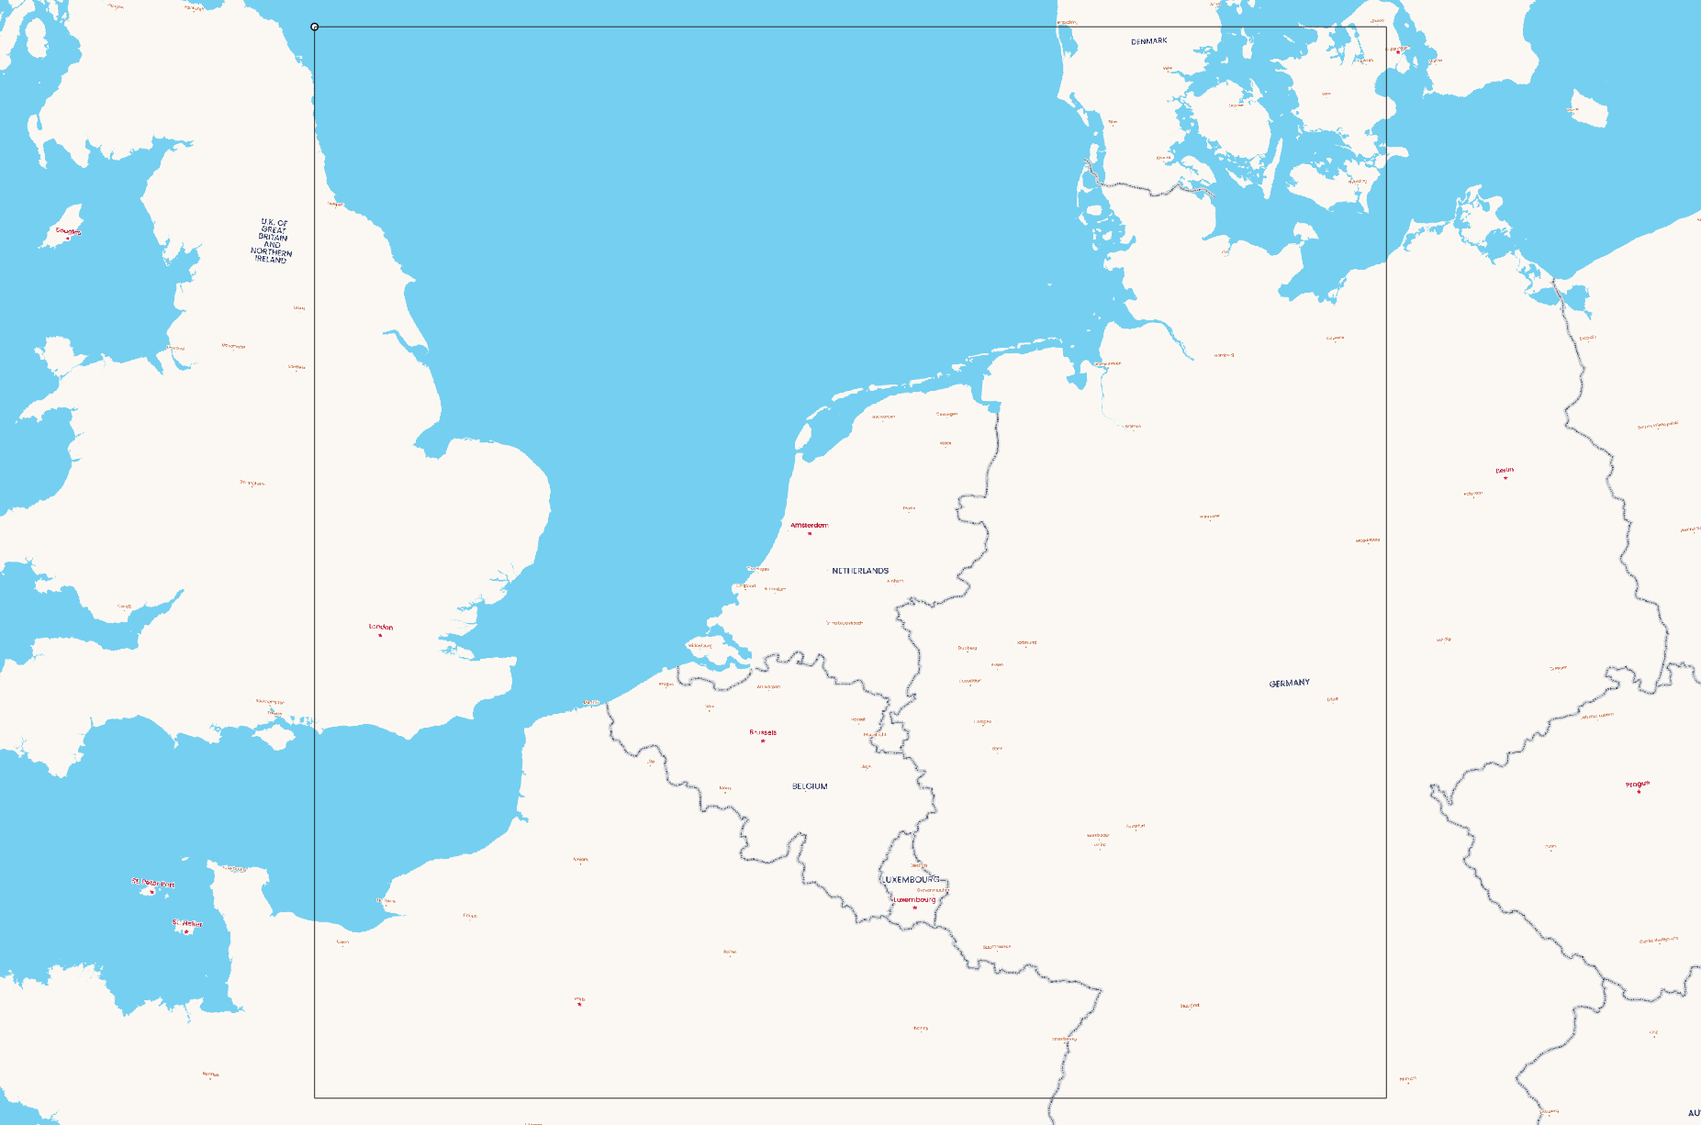
Point of origin

Slide 7
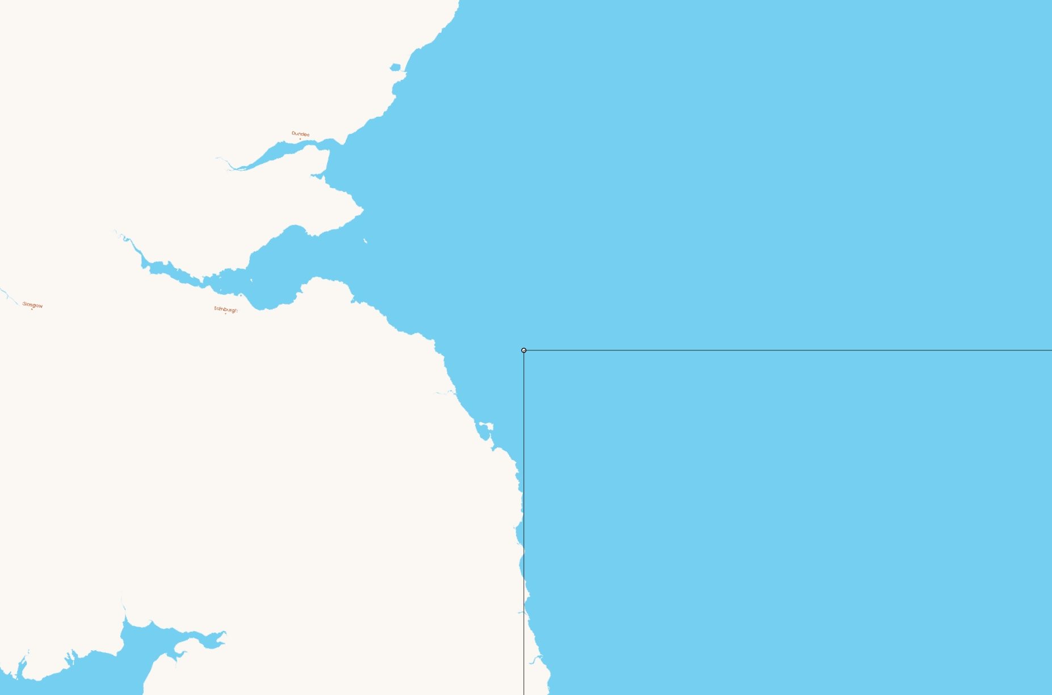
Point of origin

Slide 8
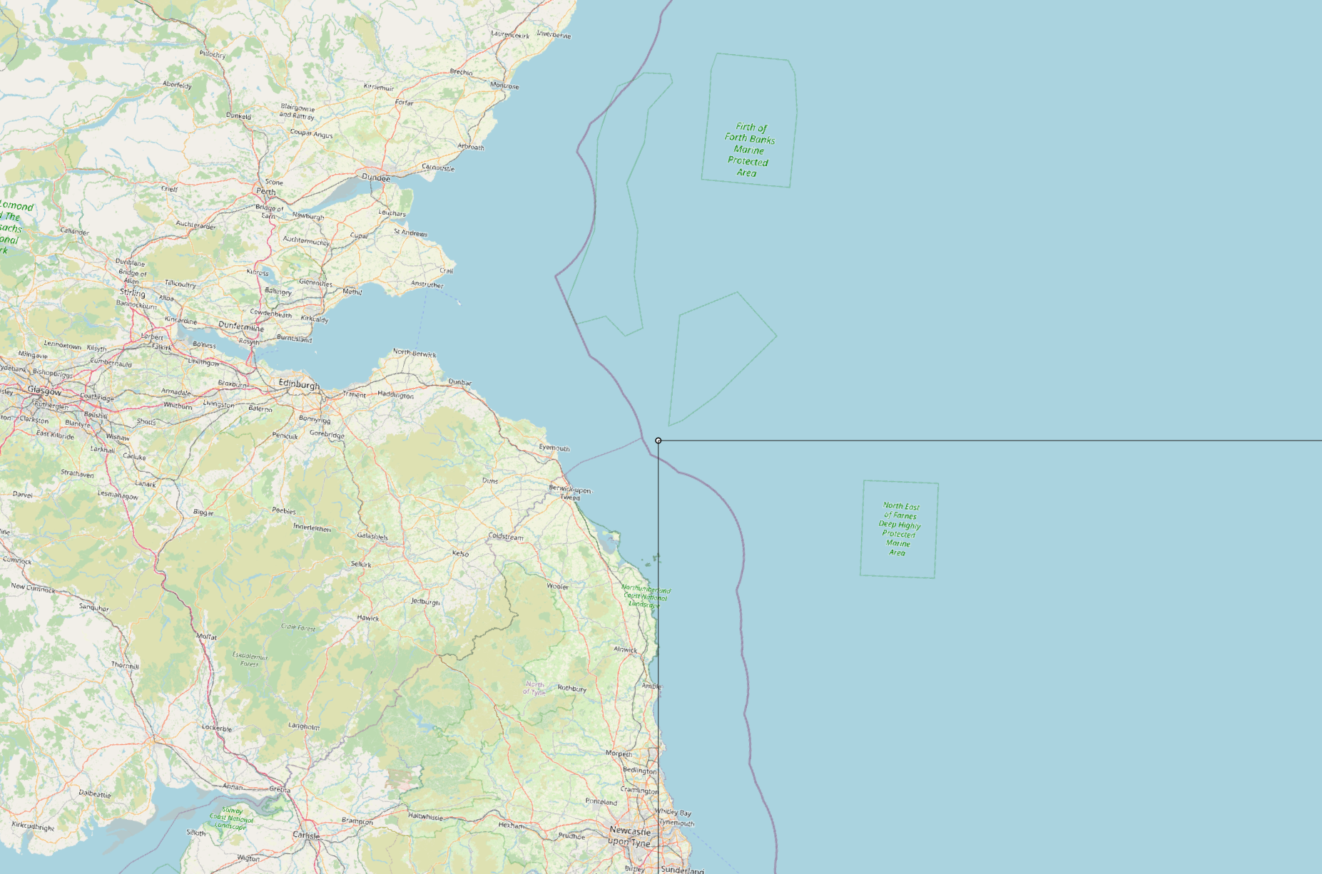
Point of origin

Slide 9
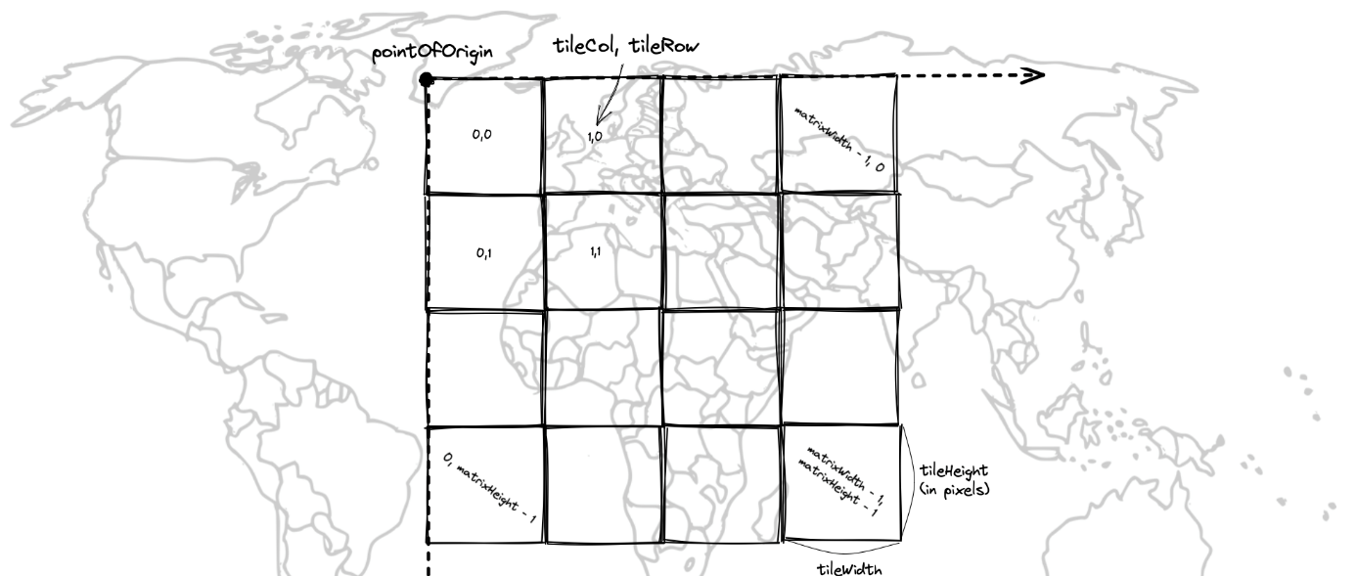
Tile matrix

Slide 10
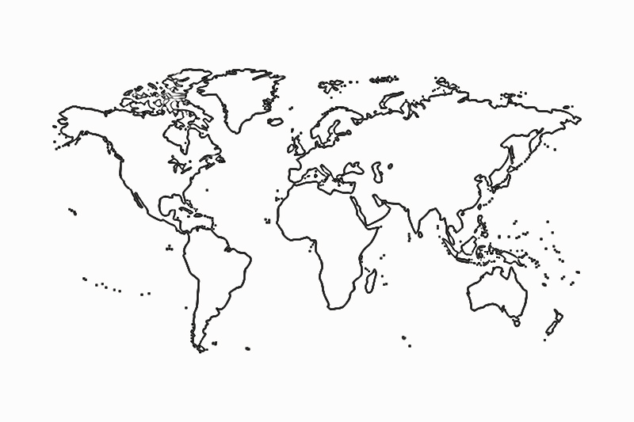
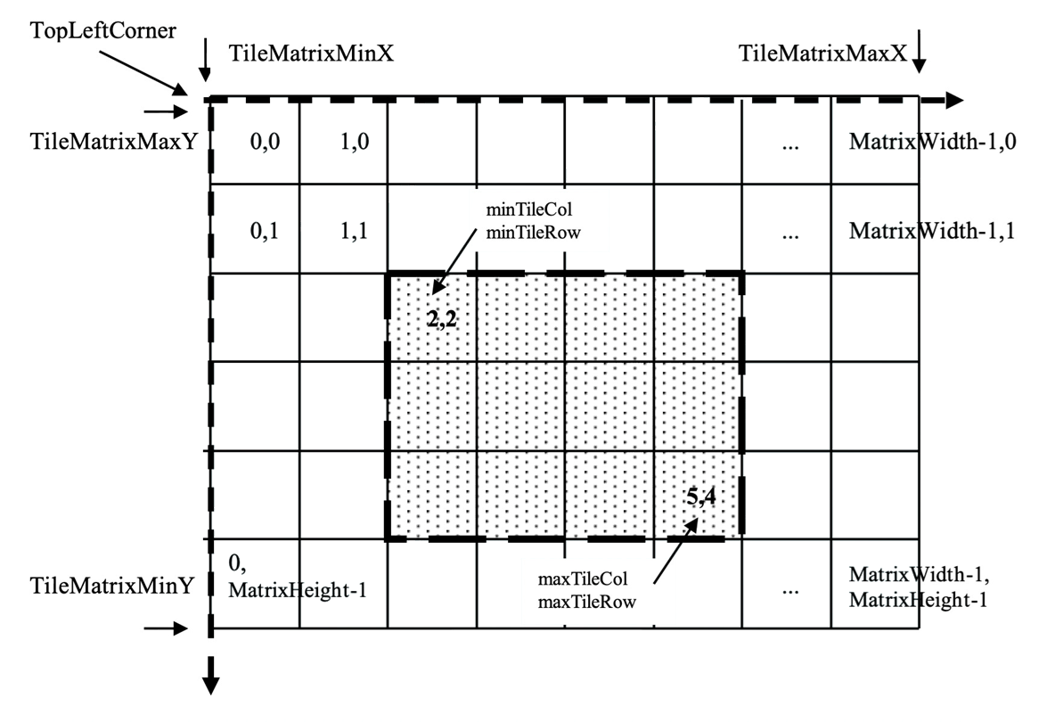
TileMatrixSet
https://docs.ogc.org/is/17-083r2/17-083r2.html

Slide 11
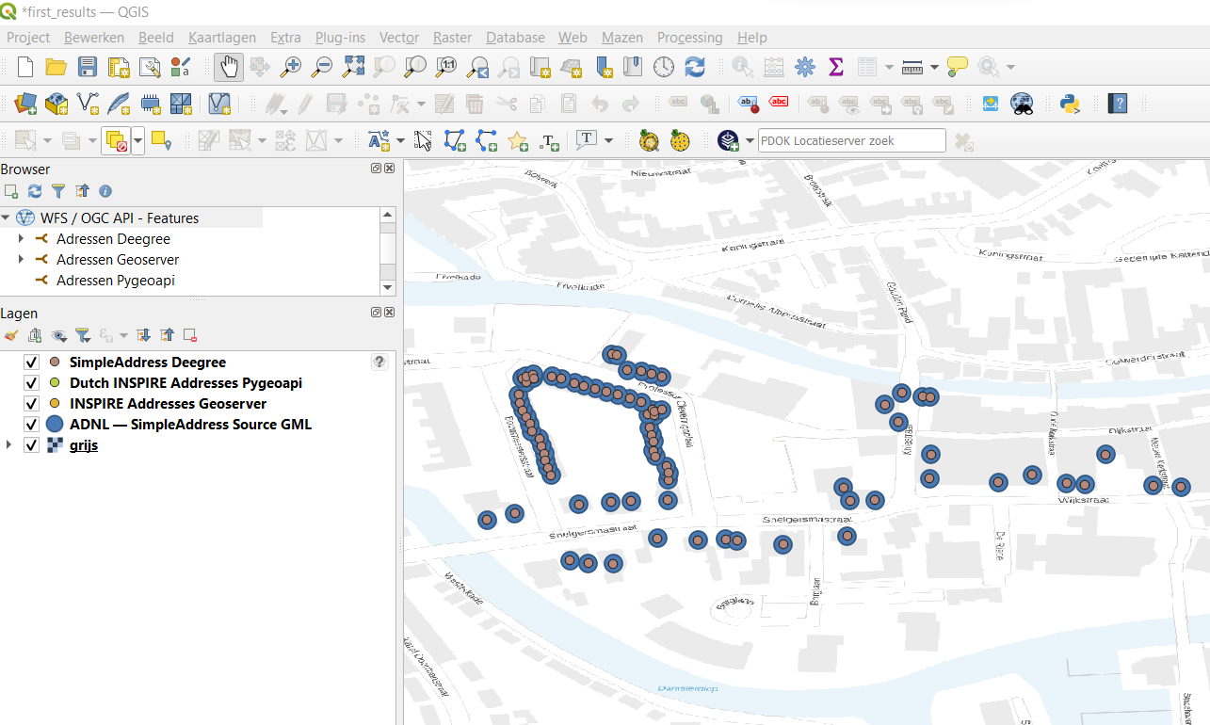
Demo OGC-API-Features in QGIS

Slide 12
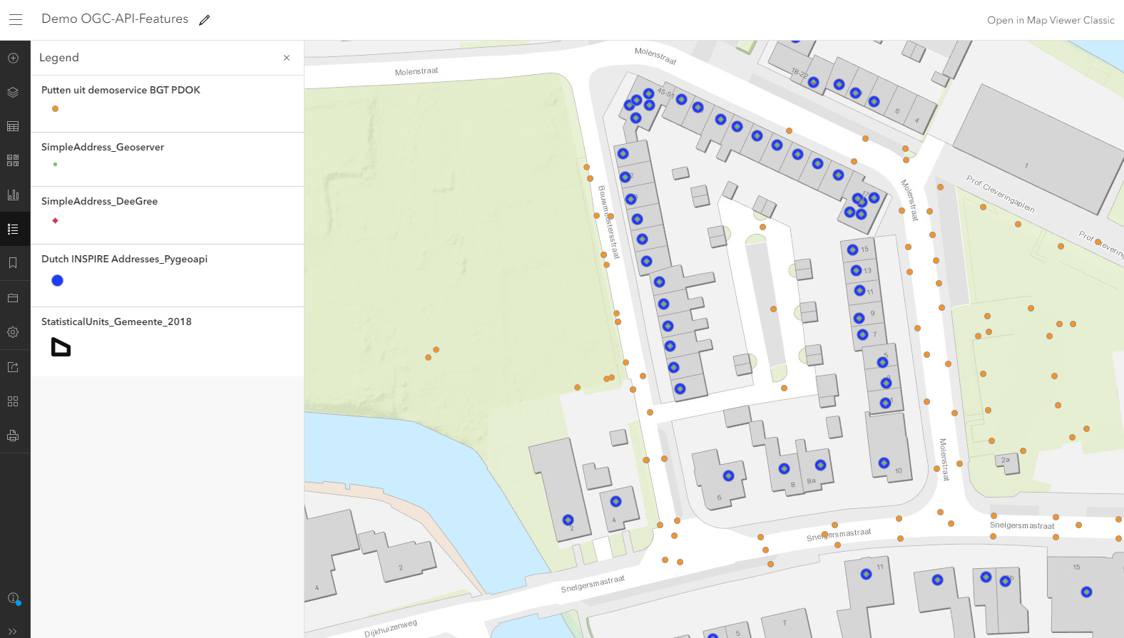
Demo OGC-API-features in ArcGIS Online
Notes:
Noem ook gebruik mogelijk via Leaflet of Openlayers of gewoon via browser (f=html)

Slide 13
Dank voor de aandacht!

